Slide 1
China 2.0
Tim Rocks, Head of Market Research and Strategy, BTIS

Slide 2
China bouncing
  There has been a major change in government priorities. The government has softened its hard line reform agenda and refocussed on economic growth.
  The effect could last around 2 years because this is the length of the construction cycle.
  However, extra credit ultimately adds to financial strains so cannot be sustained for too long.

Slide 3
China 2.0 e-commerce
China leads the world in ecommerce with more to follow:
No legacy assets like shopping malls
Less regulation that acts as a barrier. Companies were able to build “closed loops” including banking, distribution as well as retail
Massive scale
Government assistance. The government gave away 4G spectrum

Slide 4
China 2.0: fintech disruption
Alibaba will reshape global commerce
A progression from transaction then payments then banking then credit bureau then wealth management products the accounting also seem natural when you have a closed loop “marketplace”:
  If you know a companies payment history you can start micro-lending or selling data as a credit bureau. And since you hold cash on escrow you have money to lend.
  If your clients hold excess cash in their accounts, why not offer them a better return? Alibaba became one of the largest wealth firms in the world in a matter of months.
  If your clients mostly transact through your website, why not offer accounting? Alibaba has become one of the largest cloud computing software companies in the world.

Slide 5
China 2.0: tourism
Chinese tourism is already having a major impact

Slide 6
China 2.0: tourism
But there is much more to come…
Winners include casinos, airlines, airports, accommodation, attractions, flagship retailers, wine and skin products and construction
Fun holiday?

Slide 7
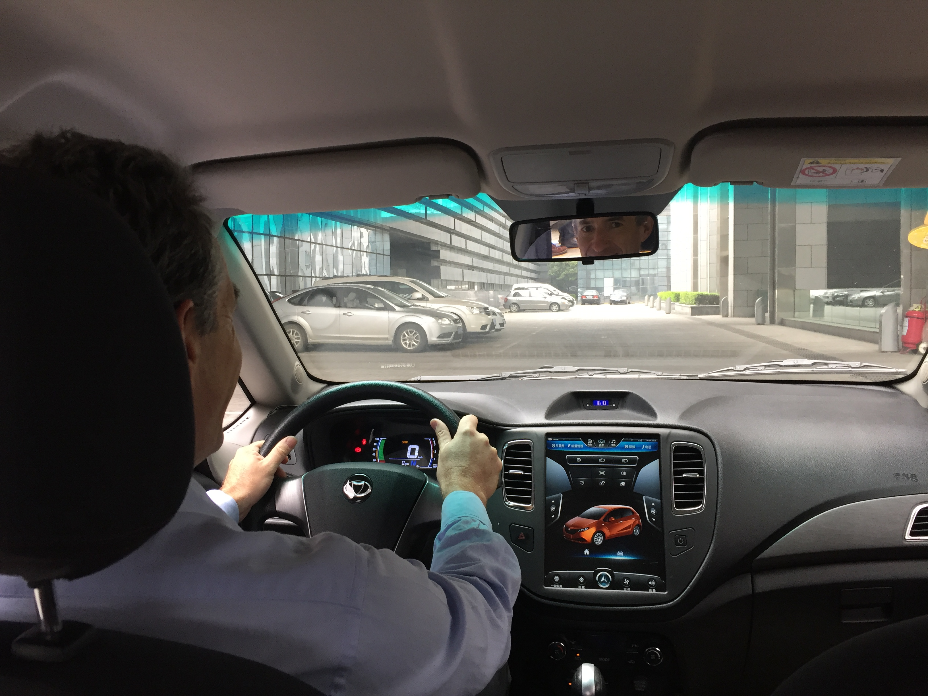
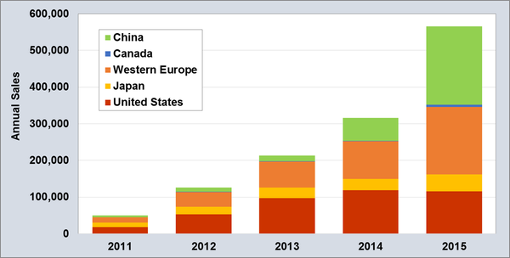
China 2.0: Electric Vehicles
Electric vehicles take up is happening fast. Sales have been growing at 60% per year.
There will be 1 million electric vehicle sold in 2016, half of which will be in China. China targeting 5 million by 2020 – 20% of auto sales.
Plug in EV sales globally

Slide 8
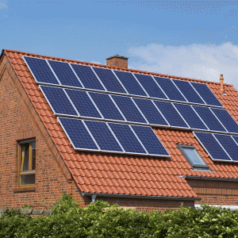
Clean tech boom
Rapid and complimentary advances in battery, solar and electric vehicle technology are combining to create one of the most significant transformations in economic history.
This could all happen much faster than you think:
  No more petrol vehicles
  Most energy from solar
  Most households off the electrical grid
There will be major winners and losers from this
+
+
=
Boom

Slide 9

Tech take up is always under-estimated
In 1985, AT&T forecast for cell-phone adoption by the year 2000:
900,000 subscribers

Slide 10
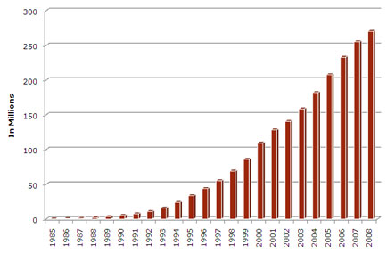
Tech take up is always under-estimated
In 1985, AT&T forecast for cell-phone adoption by the year 2000:
900,000 subscribers
The actual number was 109 million
US cell phone ownership

Slide 11
Best selling luxury car model in America in 2015

Slide 12
EVs are better cars
EVs are superior for a few reasons:
Combustion engines only 20% energy efficient vs 95% for EV.
EV will cost at least 10 times less to fuel ($300/yr vs $3000/yr)
Maintenance will be much less. There are less than 100 moving parts in EV compared with 2000 for conventional cars and much less complicated parts (transmission, clutch, crankshafts etc)
…and they will soon be cheaper cars

Slide 13
Battery costs are collapsing with scale
The battery cost in the EV will fall from $35,000 to $8,000 over the next five years

Slide 14
Cost of electric vehicle
Purchase cost parity by 2020 but operating costs head towards zero. GM Bolt will be $37,000 in 2017 and Foxconn is targeting $15,000

Slide 15
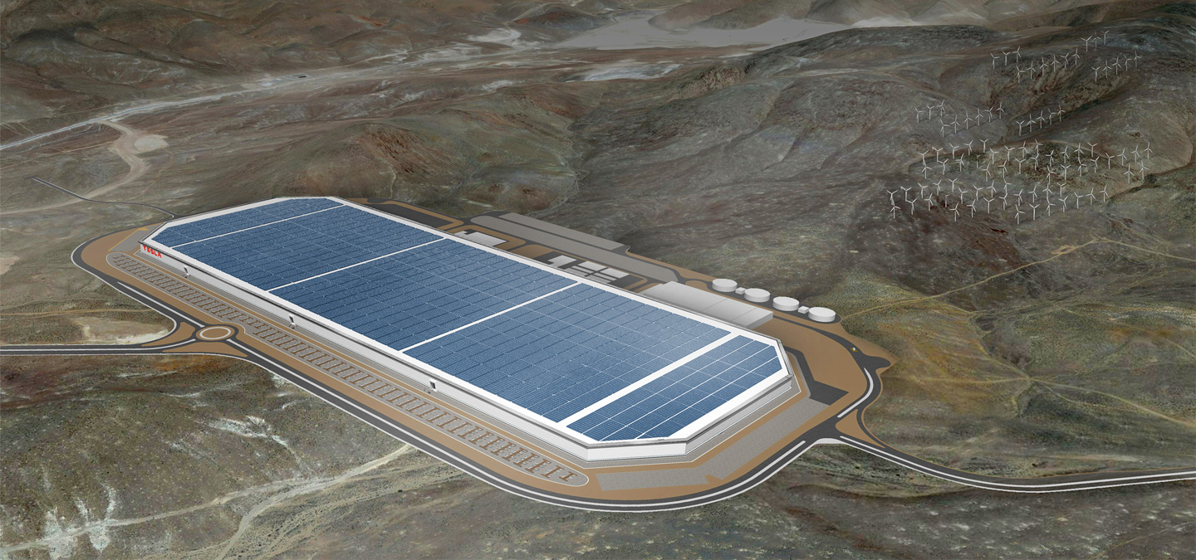
Tesla Gigafactory Construction
Will open in 2017 and cost $5 bill. It will build enough batteries to run 500,000 cars and reduce costs by 30-50%.

Slide 16
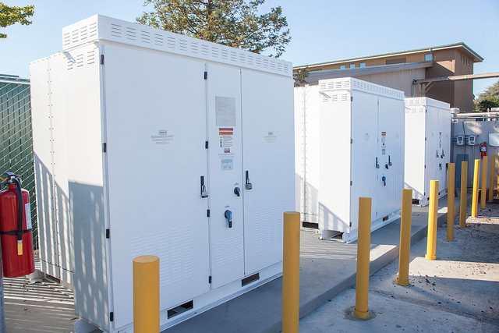
Tesla Powerwall & Powerpack

Slide 17
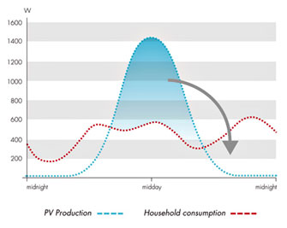
Batteries make solar viable

Slide 18
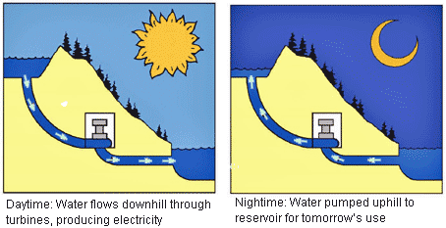
Hydro is inefficient storage

Slide 19
Grid defection in Australia

Slide 20
Solar is here
Solar installed capacity has been growing at 41% per year.
If this rate continues, it will meet 100% of energy needs by 2030

Slide 21
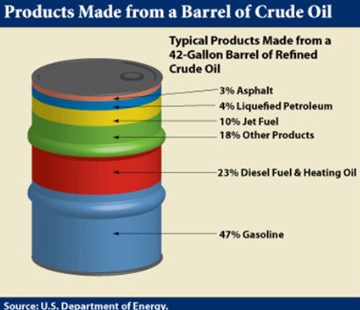
Implications are significant
60% of oil is used for land transportation
What happens to the electrical grid?
Mechanics and car dealers?
Lithium and graphite producers are major winners

Slide 22
Lithium boom – Orocobre (ORE AU)

Slide 23
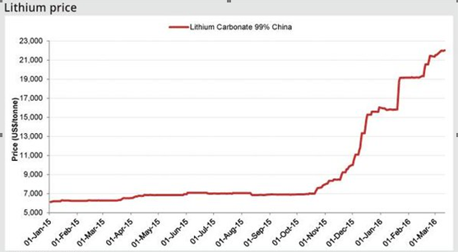
Lithium price

Slide 24
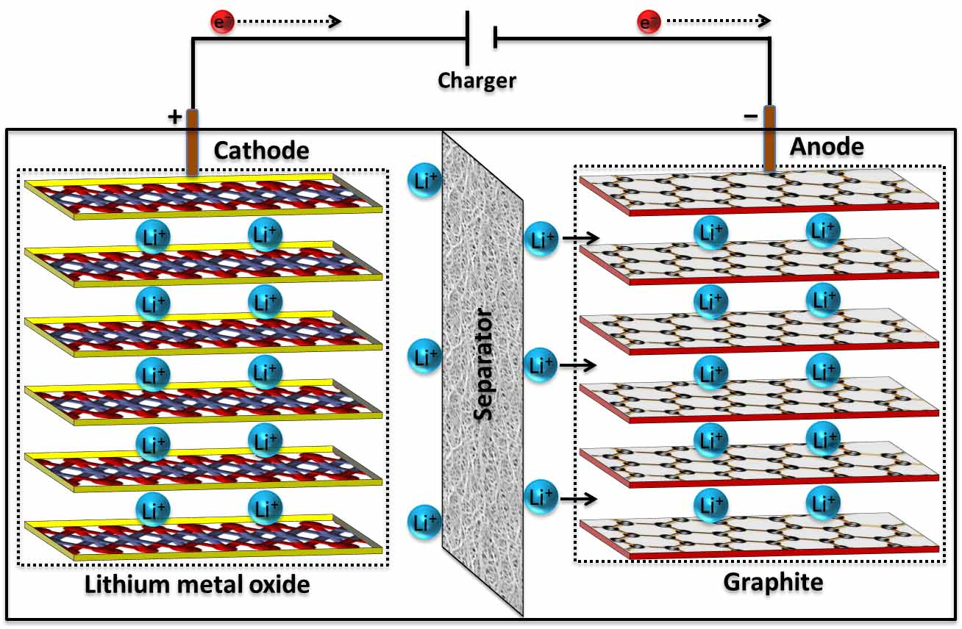
Graphite boom – Syrah Resources (SYR AU)

Slide 25
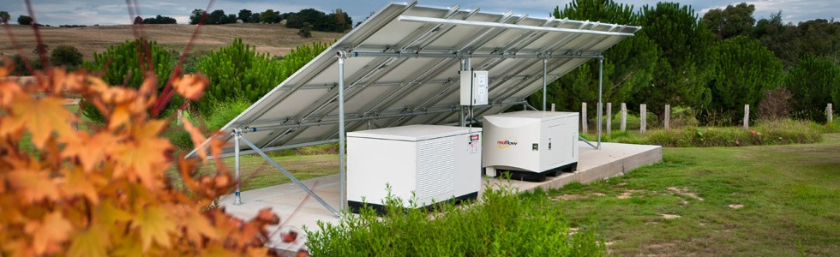
Redflow already producing (RFX AU)

Slide 26
Smart meter boom – Netcomm (NTC AU)

