Slide 1
A global economic and market outlook
Dr Chris Caton
June 2016

Slide 2
Everything depends on everything else

Slide 3
Australia’s real income has been struggling

Slide 4
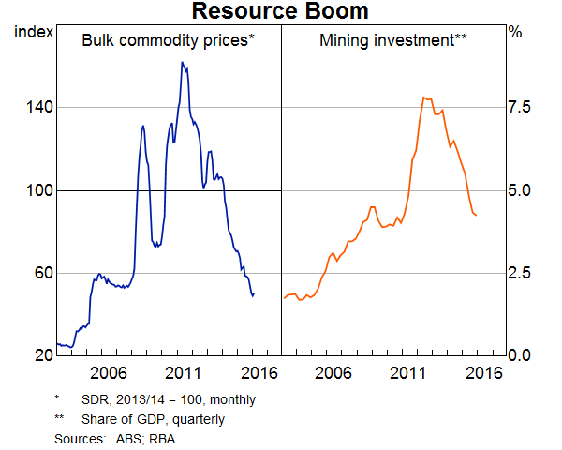
Two headwinds for the economy

Slide 5
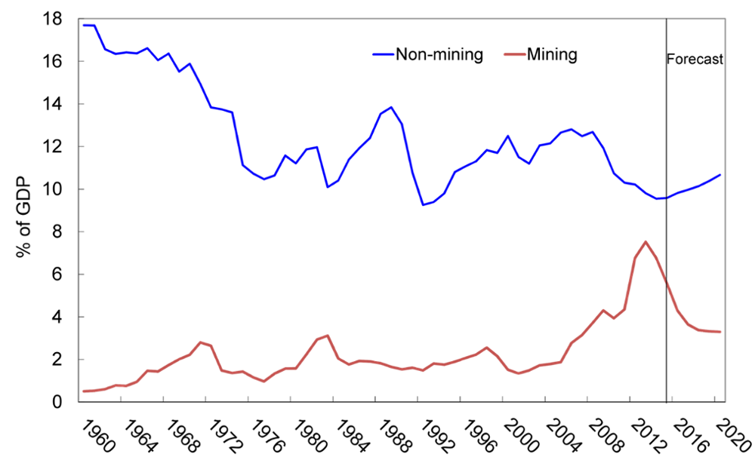
Non-mining investment has been sluggish

Slide 6
2016 Growth Forecasts (%)
Month of Forecast
 |  |  | J-15 | J-15 | A-15 | S-15 | O-15 | N-15 | D-15 | J-16 | F-16 | M-16 | A-16 | M-16
Australia |  |  | 2.9 | 2.9 | 2.9 | 2.7 | 2.6 | 2.6 | 2.6 | 2.6 | 2.6 | 2.6 | 2.6 | 2.6
New Zealand |  |  | 2.7 | 2.7 | 2.5 | 2.4 | 2.3 | 2.3 | 2.3 | 2.3 | 2.4 | 2.5 | 2.6 | 2.7
US |  |  | 2.8 | 2.8 | 2.7 | 2.7 | 2.6 | 2.6 | 2.5 | 2.4 | 2.2 | 2.1 | 2.0 | 1.8
Japan |  |  | 1.7 | 1.7 | 1.7 | 1.5 | 1.3 | 1.3 | 1.2 | 1.2 | 1.0 | 0.7 | 0.6 | 0.5
China |  |  | 6.7 | 6.7 | 6.7 | 6.6 | 6.5 | 6.5 | 6.5 | 6.5 | 6.5 | 6.4 | 6.5 | 6.5
Eurozone |  |  | 1.8 | 1.8 | 1.8 | 1.7 | 1.7 | 1.7 | 1.7 | 1.7 | 1.6 | 1.5 | 1.5 | 1.6
UK |  |  | 2.5 | 2.4 | 2.5 | 2.5 | 2.4 | 2.4 | 2.3 | 2.3 | 2.2 | 2.0 | 2.0 | 1.9
“World” |  |  | 3.1 | 3.1 | 3.1 | 3.0 | 2.9 | 2.9 | 2.8 | 2.7 | 2.6 | 2.5 | 2.4 | 2.4
Source: Consensus Economics

Slide 7
Financial Market Forecasts
 | Now (2 Jun) |  |  | End-Jun 2016 | End-Dec 2016
AUD/USD |  | 0.725 | 0.70 |  | 0.70
Official cash rate (%) |  | 1.75 | 1.75 |  | 1.50
10 Year Bond yield (%) |  | 2.29 | 2.40 |  | 2.60
ASX 200 |  | 5325 | 5400 |  | 5600

Slide 8
The Australian Dollar and US Trade Weighted Index
Index
AUD/USD
AUD/USD (RHS)
US TWI inverted (LHS)
Source: Datastream

Slide 9
The $A and the iron ore price

Slide 10
Australian Share market Performance – ASX200
Source: Bloomberg

Slide 11
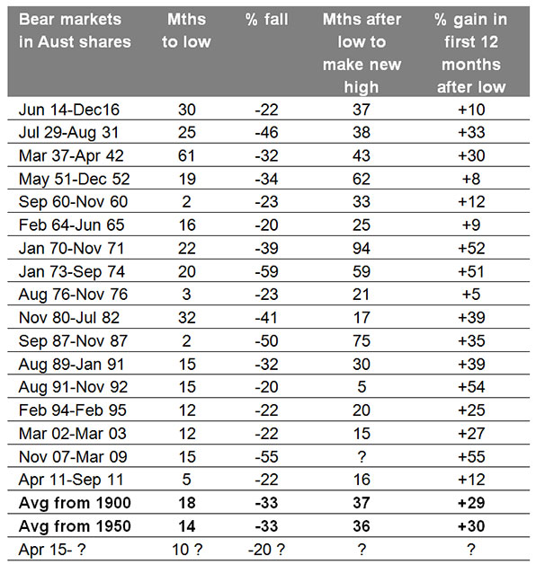
Bear markets in history

Slide 12
As conventionally measured, the Australian market is close to fair value (p/e ratio on forward earnings)

Slide 13

Market valuation has returned to supportive
levels
Interest rates v price earnings multiple of ASX 200
Official cash rate adds in out-of-cycle mortgage rate changes since Jan 2008 to the level of the cash rate.
Source: Citi Research, IBES, RBA as at April2016
Notes:
12

Slide 14
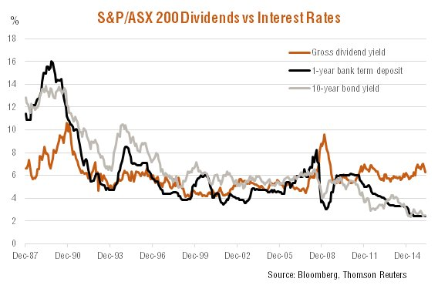
The share market yield beats the rest by a long way
(dividend yield (%))

Slide 15
The US has been the place to be

Slide 16
The labour market data are looking better. Unemployment is trending downwards while employment growth has been strong.
000’s
%
Employment (LHS)
Unemployment Rate (RHS)
Source: ABS

Slide 17
The service sector dominates jobs growth

Slide 18
Australian inflation is extremely low
%
BT Forecasts
GST Effect
Source: ABS

Slide 19
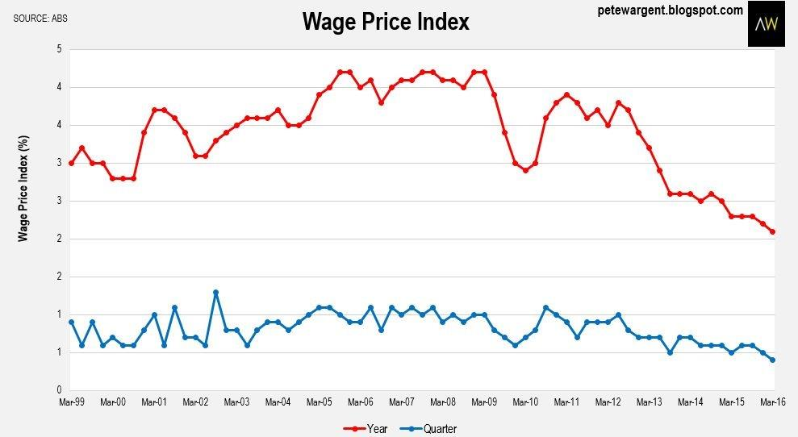
Wage inflation remains remarkably low

Slide 20
Household financial ratios

Slide 21
House Prices - Australia v Sydney
Index (1987 = 100)
Source: ABS

Slide 22
House Prices - Australia v Brisbane
Index (1987 = 100)
Source: ABS

Slide 23
House prices have risen but may be peaking ($’000s)

Slide 24
Prices have been rising rapidly in Sydney and Melbourne only in the past year (% increase year to May 2016)

Slide 25
Where’s the bubble? Average house price increase in the past ten years

Slide 26
Regional Australia has lagged

Slide 27
We’re expensive by world standards but not massively so.

Slide 28
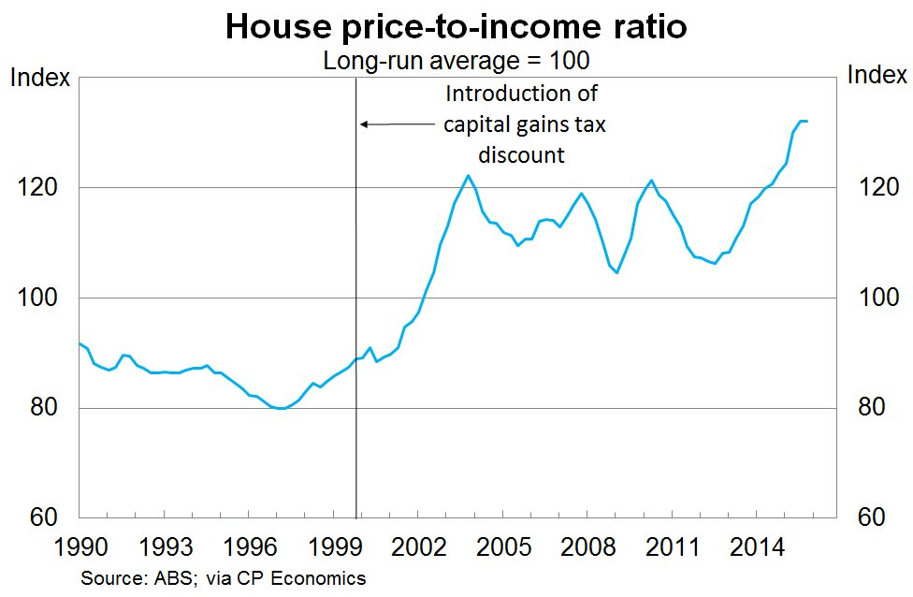
A slightly different measure

Slide 29
The owner-occupiers are taking over from investors

Slide 30
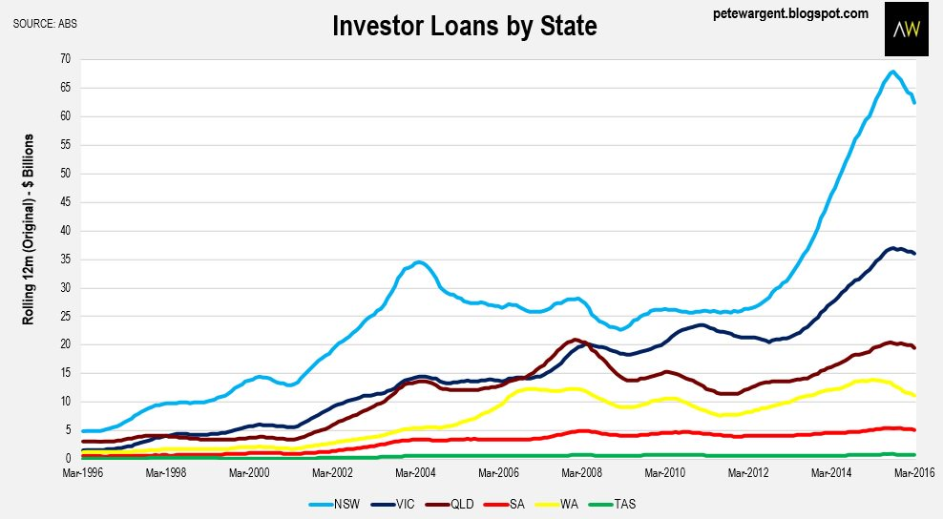
Investors were piling in in New South Wales

Slide 31
Gross Domestic Product
%
BT Forecasts
Source: ABS

Slide 32
Global Medium-Term Economic Growth and Inflation Prospects (2016-2026)
 | GDP | Inflation
Australia | 2.7 | 2.5
New Zealand | 2.5 | 1.8
Sweden | 2.3 | 2.0
United States | 2.2 | 2.2
United Kingdom | 2.1 | 1.9
Norway | 2.0 | 2.1
Spain | 1.9 | 1.7
Canada | 1.9 | 1.9
Netherlands | 1.6 | 1.6
Eurozone | 1.5 | 1.7
Germany | 1.4 | 1.6
Switzerland | 1.4 | 0.9
France | 1.4 | 1.5
Italy | 1.2 | 1.5
Japan | 0.8 | 1.2
Ss: Consensus Economics

Slide 33
Asia-Pacific Medium-Term Economic Growth and Inflation Prospects (2016-2026)
 | GDP | Consumer Prices
India | 7.7 | 5.2
China | 5.6 | 2.3
Indonesia | 5.5 | 4.7
Philippines | 5.4 | 3.3
Malaysia | 4.5 | 2.7
Thailand | 3.0 | 2.2
Australia | 2.7 | 2.5
Singapore | 2.6 | 1.7
Hong Kong | 2.5 | 2.5
New Zealand | 2.5 | 1.8
South Korea | 2.3 | 1.9
Taiwan | 2.2 | 1.6
Japan | 0.8 | 1.2
Source: Consensus Economics

Slide 34
Summary
The big question in the US has shifted from when rates will begin to rise to how rapidly they will do so.
We will always worry about China, but we shouldn’t worry about its share market.
The Australian economy should continue to experience only moderate growth. The mining investment boom has ended with no significant pickup to date in non-mining capex.
The cash rate is likely to fall again.
The exchange rate is close to fair value.
The Australian share market is cheap when compared with other forms of investment.

Slide 35
So long and thanks for all the fishes

Slide 36
Disclaimer
This presentation has been prepared by BT Financial Group Limited (ABN 63 002 916 458) ‘BT’ and is for general information only. Every effort has been made to ensure that it is accurate, however it is not intended to be a complete description of the matters described. The presentation has been prepared without taking into account any personal objectives, financial situation or needs. It does not contain and is not to be taken as containing any securities advice or securities recommendation. Furthermore, it is not intended that it be relied on by recipients for the purpose of making investment decisions and is not a replacement of the requirement for individual research or professional tax advice. BT does not give any warranty as to the accuracy, reliability or completeness of information which is contained in this presentation. Except insofar as liability under any statute cannot be excluded, BT and its directors, employees and consultants do not accept any liability for any error or omission in this presentation or for any resulting loss or damage suffered by the recipient or any other person. Unless otherwise noted, BT is the source of all charts; and all performance figures are calculated using exit to exit prices and assume reinvestment of income, take into account all fees and charges but exclude the entry fee. It is important to note that past performance is not a reliable indicator of future performance.
This document was accompanied by an oral presentation, and is not a complete record of the discussion held.
No part of this presentation should be used elsewhere without prior consent from the author.
For more information, please call BT Customer Relations on 132 135 8:00am to 6:30pm (Sydney time)

